Slide 1

Team alien

Slide 2

THE TEAM
Sarah Dagher
Greg Rosen
Lazarus Goosby

Slide 3
Premise
Do a deep dive into the shapes of different UFO’s
Examine what regions are most likely to have UFO sightings

Slide 4
Data sources AND EXPLANATIONS
https://www.kaggle.com/NUFORC/ufo-sightings
Data was cultivated from work of the National UFO Reporting Center (NUFORC)
From the original project’s ReadMe:
“Full acknowledgement to the NUFORC organization and its trials and tribulations to capture and present this data to the world is acknowledged here. Sadly repeated contacts with NUFORC have left a bitter ugly introverted taste leading to a no reply context. Something akin to a bow finger. This project is the exciting humble technological reply.”

Slide 5
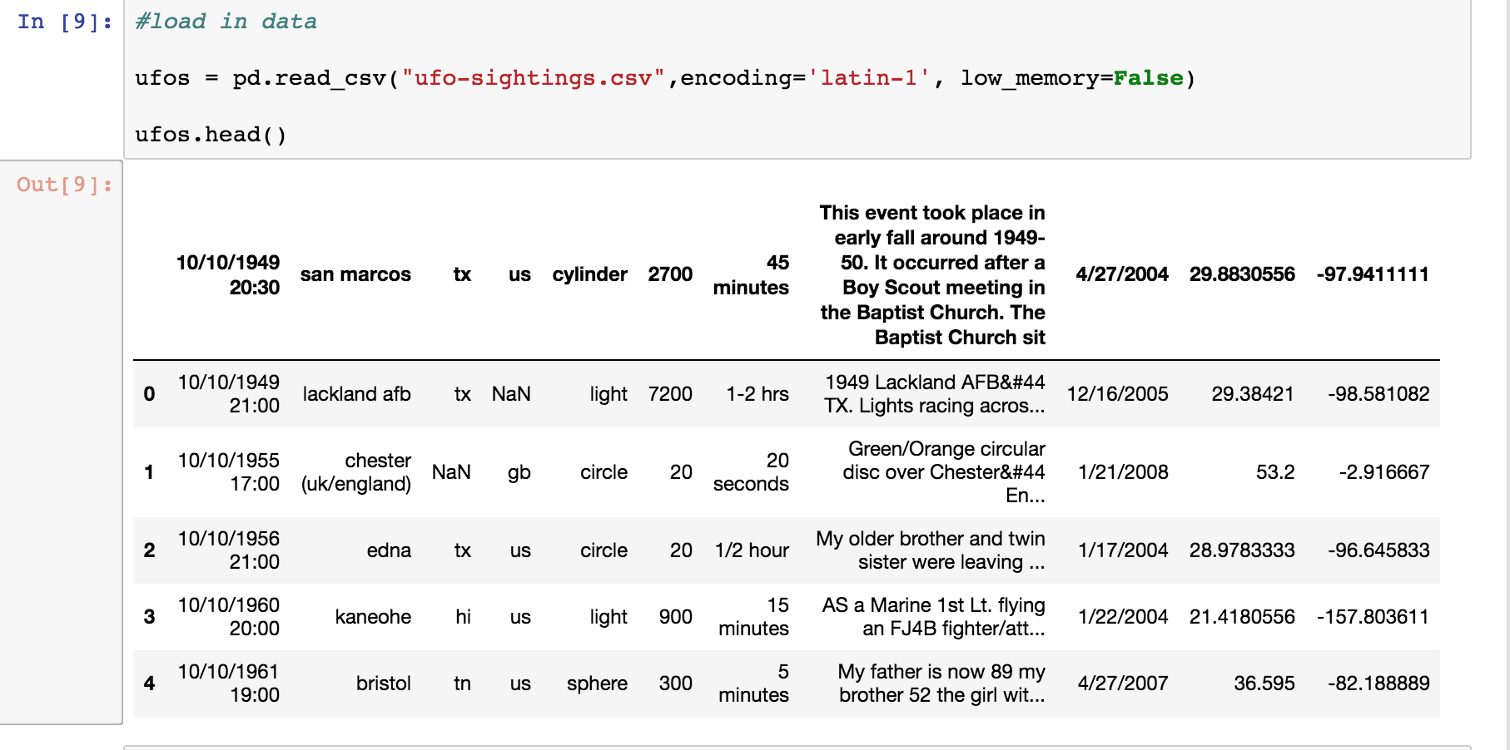
Loading Data

Slide 6
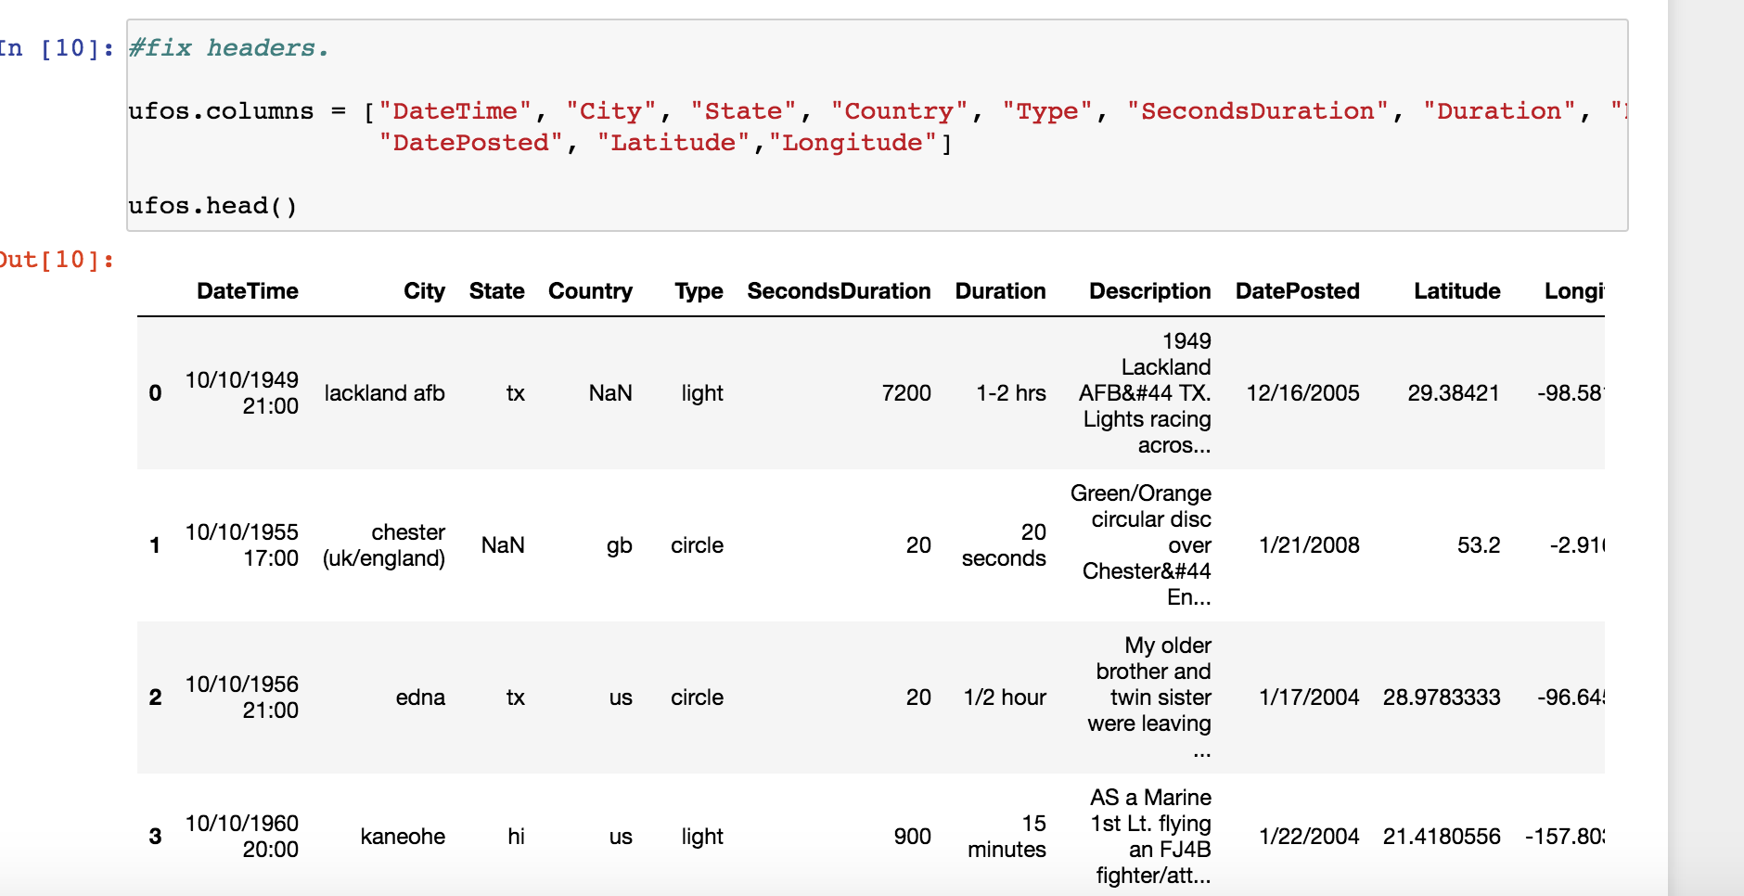
Fixing the headers

Slide 7
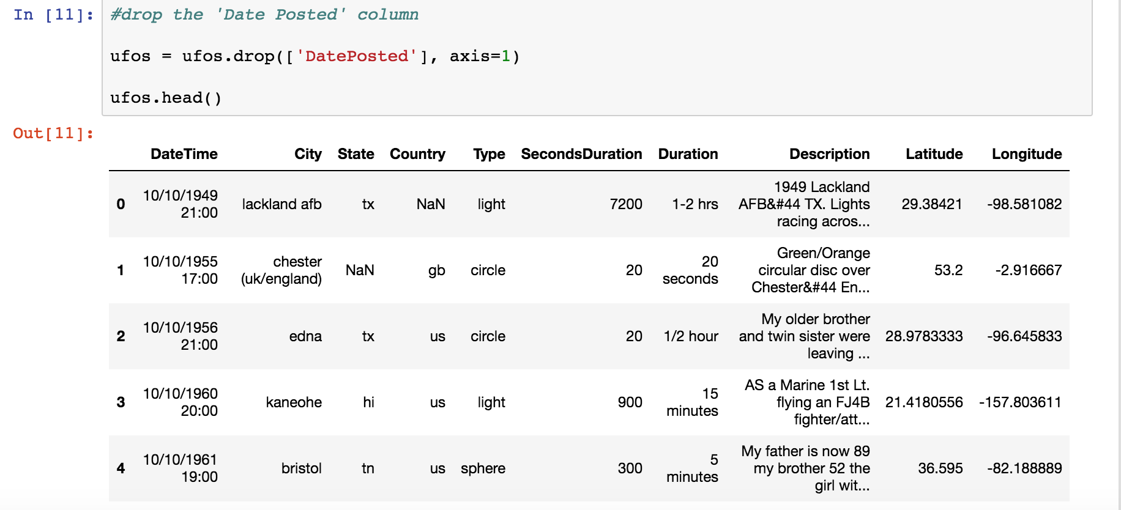
Getting rid of “date posted” field

Slide 8
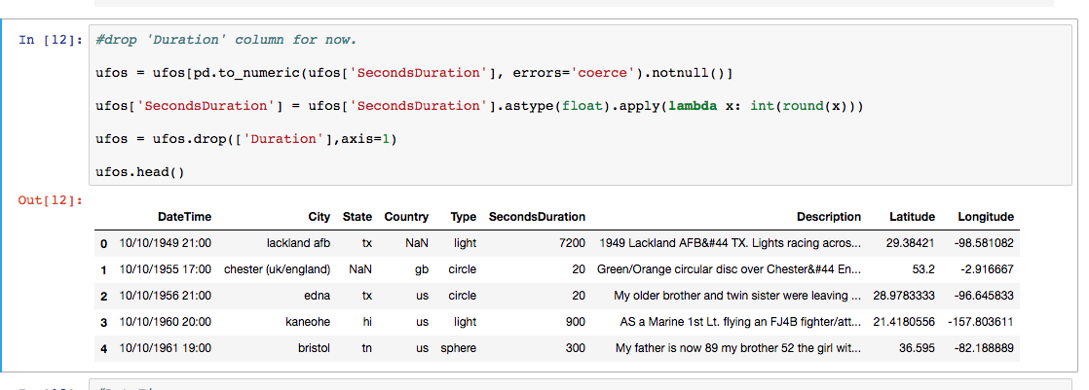
Dropping duration column

Slide 9
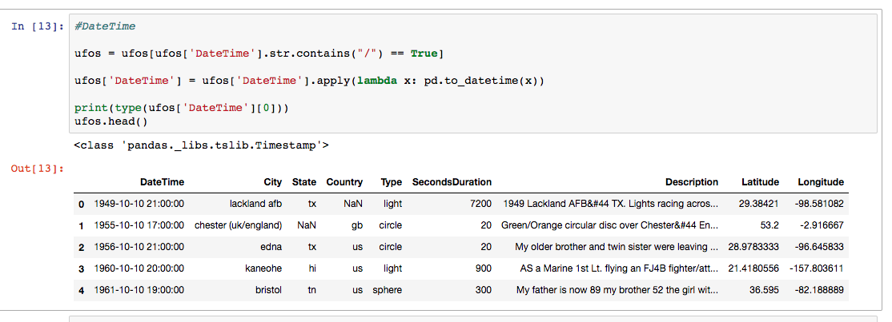
Formatting datetime

Slide 10
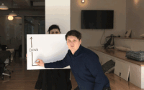
It’s time for some graphs!

Slide 11
TABLEAU MAP!
https://public.tableau.com/shared/DTDCYC4RP?:display_count=yes

Slide 12
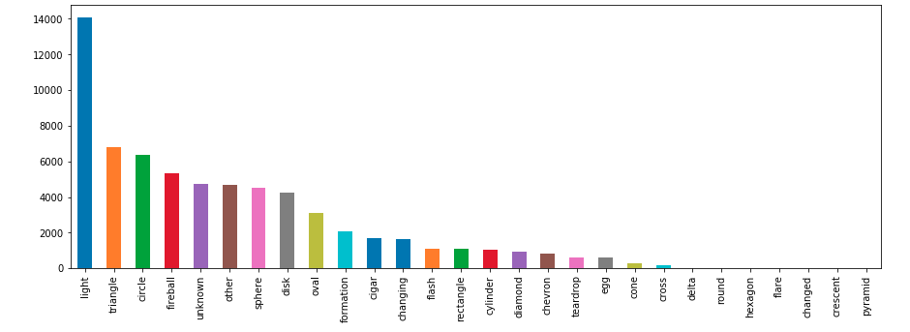
ufo sightings by shapes

Slide 13
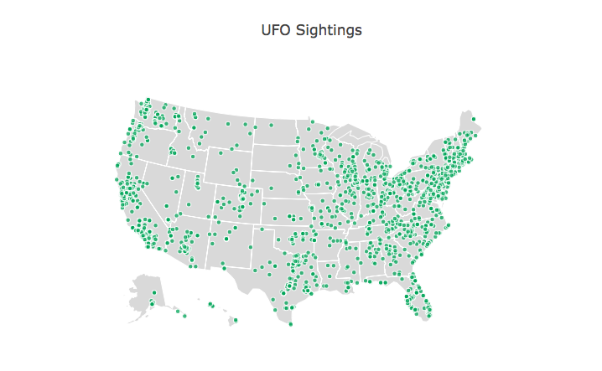
u.s. map of ufo sightings

Slide 14
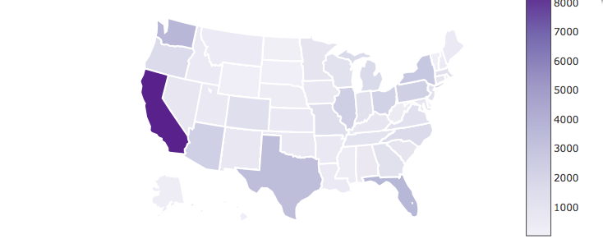
UFO Sightings BY StATE (MAP VERSION)

Slide 15
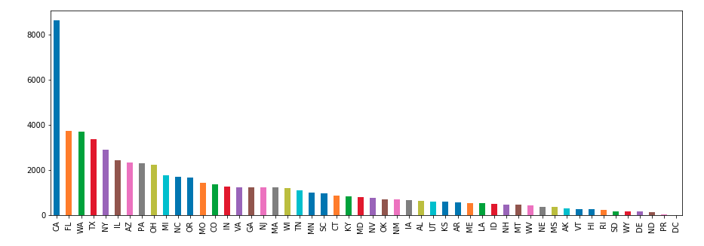
Ufo sightings by state (GRAPH VERSION)

Slide 16
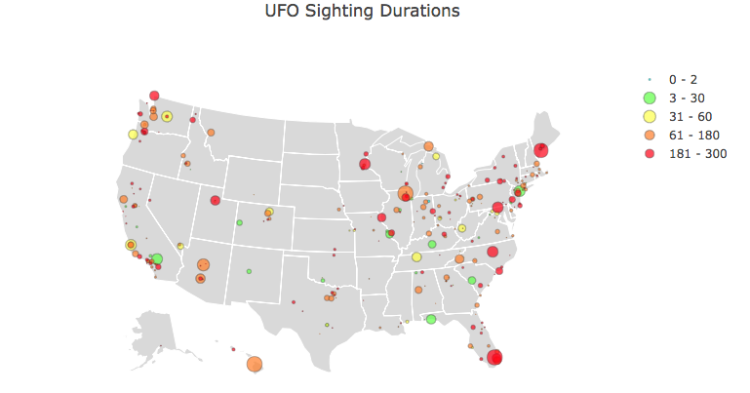
Ufo sightings by duration

Slide 17
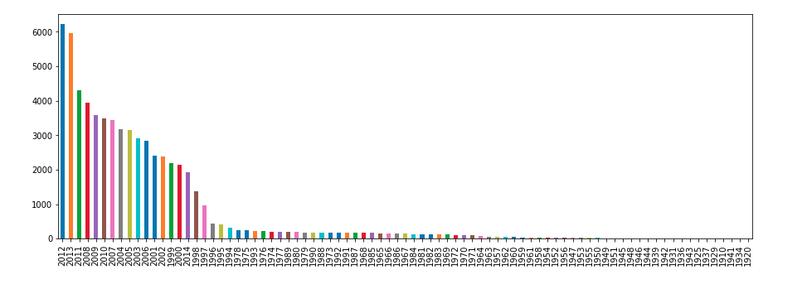
Reported sightings by year

Slide 18

Machine learning code demo

Slide 19
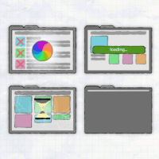
The webpage

Slide 20
FINAL INSPIRATION
“As our future challenges as a species may include our personal perspectives on intelligence, life, society and living on this and other worlds. An inter dimensional or inter stellar contact in this context is priceless and could change personal and societal perspectives/values. To hold down the human spirit has taught us repeatedly that truth of some kind will eventually pervade. Thank you Github!”
-Sigmond Axel, Creator of This Dataset and Normal Average Guy, 6/21/2014

Slide 21

Questions?

